Slide 1
4. Study of Start up and termination

Slide 2
Content
Startup process
Boot option
Init option
Notes:
The startup of a machine includes several stages. First is the BIOS booting process. After that booting is controlled by boot loader. This program allows us to select the OS and parameters to boot.
Then the OS will charge for starting auto start program to active the basic functions for users.
In this chapter, we will discuss about the two latest booting process

Slide 3
Startup process
Login prompt displayed
When Linux ﬁrst loads after booting the computer
After another user has logged out
Need to enter a username and password
The login prompt may be graphical or simple text
If text, logging in will present a shell
If graphical, logging in will present a desktop
Some combination of mousing and keystrokes will make a terminal window appear
A shell runs in the terminal window
Notes:
We describe the flow of processing from power-on of the computer to start-up of the Linux system. The following shows the flow of Linux start-up.
(1) The BIOS (Basic Input/Output System) on the mother board starts when the power supply is turned on.
(2) BIOS checks hardware and memory, if no abnormality is found, the boot process begins from the first boot device set.
(3) The boot loader starts, and it reads the kernel image.
(4) When the kernel finishes its own initialization, it will then load and execute the '/sbin/init` process. The '/sbin/init' process is a process which starts first in the system. This process start up the system according to the procedure described in the '/etc/inittab' file.
(5) The login prompt appears after all initialization ends.

Slide 4
Boot Loader
Small program to load the kernel from the storage
Where is this program?
1st cluster of hard disk
1st cluster of partition
Small program: simple loading
No authentication
No virus protection
Solution: 2 stage loader
lilo
grub
Notes:
In Linux, the kernel is loaded in the memory when the power supply is turned on. In order to read the kernel into the memory, a program called Boot loader is necessary. This program is read automatically at the power-on and executed.
Typical boot loaders of Linux are as follows.
• GRUB : The most popular boot loader in Linux
• LILO: Boot loader traditionally used with Linux
Additionally, there are commercial boot loaders supporting a lot of OS such as 'System Commander'.
In Red Hat Enterprise Linux, ‘GRUB’ is a standard boot loader.
If you select the boot loader in installing it or reinstall the boot loader, ‘LILO’ can also be used as well.

Slide 5
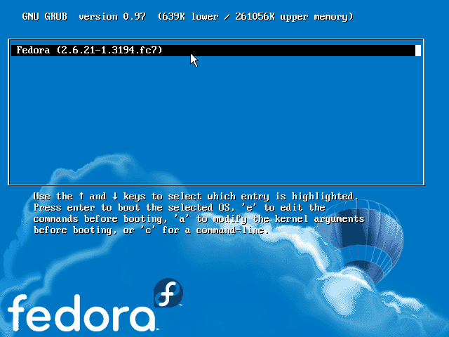
Grub bootloader
Notes:
GRUB (GNU GRand Unified Bootloader) is a boot loader developed by GNU project. The features of GRUB are:
It is possible to change the setting of the system at startup, even when the system can not boot.
It support the system start-up of Linux, as well as various operating systems such as FreeBSD and Windows.
Setting can be protected with password.
The Configuration file of GRUB is '/boot/grub/grub.conf'. The edit of configuration file enables the selection of the start-up partition and the setting of the parameter passed to the kernel, etc.

Slide 6
Lilo Boot Loader
Old style loader
Stored in the MBR of the HDD or Partition
Boot data is in /boot
Problem when lilo can not read the /boot
lilo.conf
Notes:
In the traditional boot loader used with Linux, there is LILO (LInux LOader). LILO is mounted as standard in various distributions.
LILO consists of the program which is preserved on the disk's MBR, on the partition head or on the floppy disk, and the data located under the /boot directory.
The '/etc/lilo.conf' file is a configuration file used when LILO is installed.
Execute the lilo' command when you store on the disk. The lilo.conf' file is automatically read from the ‘lilo' command.
It is necessary to do this file setting after understanding the mechanism of booting the IBM PC/AT compatible machine. Be careful especially when you execute multi-boot with another OS, as it may cause the other OS not to start. Refer to 'man' of ‘lilo' and ‘lilo.conf' for details.
And, refer to the following HOWTO documents.
http://www/linux.or/jp/JF
• About the operation of LILO
• The basic knowledge of hard disk drive

Slide 7
Init
Notes:
The ‘init' process is created at the system start-up, and it becomes the base of all the processes. The ‘init' process prepares the system by referring to the '/etc/inittab' file. It then interprets the runlevel which is specified in the ‘inittab’ file and then starting all the processes that the run level needs.
The run level is an operation mode of the system, and it has seven levels from 0 to 6. The 'init' process can be used as a command to change the run level while the system is operational. You can modify it by specifying the run level as an argument of the ‘init' command. For example, if you execute the 'init' command with 5 as an argument, the status will be the run level 5.
The inittab contents information about booting process. This includes:
Information about run levels. Linux has 6 runs levels from 1 to 6. Each time system boot in to one of these level. Inittab defines what program and how they run in each level. It defines also which level is default when the system booting.
Information about startup directory.
Information about text shells started as boot.

Slide 8
inittab syntax

Slide 9
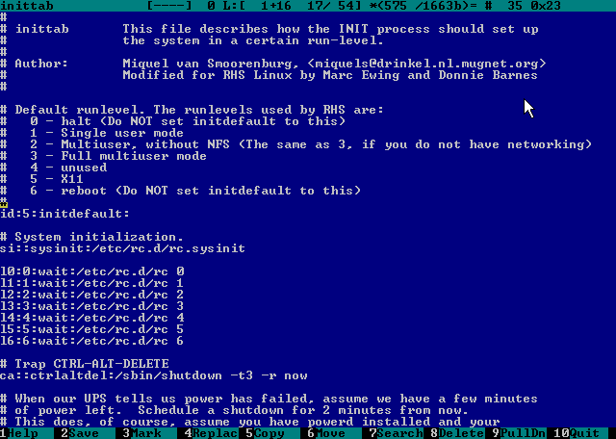

Slide 10
Execution Levels
RunLevel | Description
0 | Halt system
1 | Single User Mode
2 | Multi User Mode (No NFS)
3 | Text MultiUser Mode
4 | Reserved
5 | Graphical MultiUser Mode
Notes:
The runlevel 3 is CUI (Character User Interface) multiuser mode. In order to start GUI (Graphic User Interface), we specify the GUI multi user mode of the runlevel 5. Specify the runlevel 1 as the single user mode, when you do not want other users to access the system. For example, when you are performing backup of the file system, or when you are inspecting the file system. In addition, there are runlevels shown in the above table. Level 2 allows multiple users work on an isolated machine. Level 5 is fully graphical multisuermode.
You can check the present runlevel with the ‘runlevel' command.

Slide 11
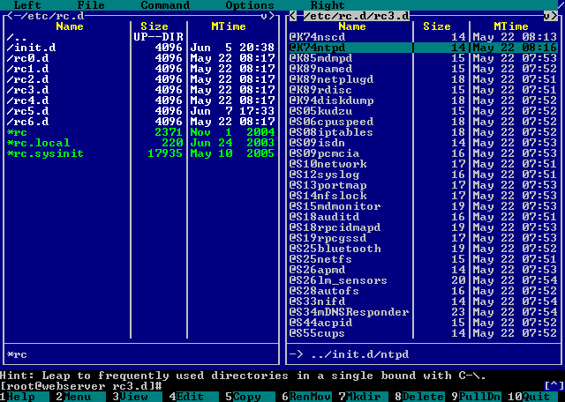
rc: startup directories
Notes:
In each level of execution, the processing of each line level is set. For example, when the default line level is 3, the '/etc/rc.d/rc' script is executed by argument 3. In the 'rc' script executed here, the procedure of starting and stopping the service type called 'stand-alone' is defined. The details will be described in Chapter 6.
In innittab file, there is a session for the processing when you press the keys [Ctrl] + [Alt] + [Del] is defined. Here, the case to reboot the system immediately is described.

Slide 12
Login
To login into the system, user need username and password
User can login into a terminal
By default, linux system has 6 terminal (tty1-tty6), tty; teletype writer
tty 7 is for graphics interface
To switch between ttys use alt-fx
To customize the number of ttys, go to inittab
Notes:
Once login in to the system user can use text interface or graphics interfaces. Each interface is called tty. By default, Linux system has 6 terminal and 1 graphics interfaces. Ttys are numbered from 0, the last one is always graphics interface. Interfaces can be switched by pressing [alt-fx] where x is the number of the interface.
Inittab file has a session to configure how many ttys the system will start.

Slide 13
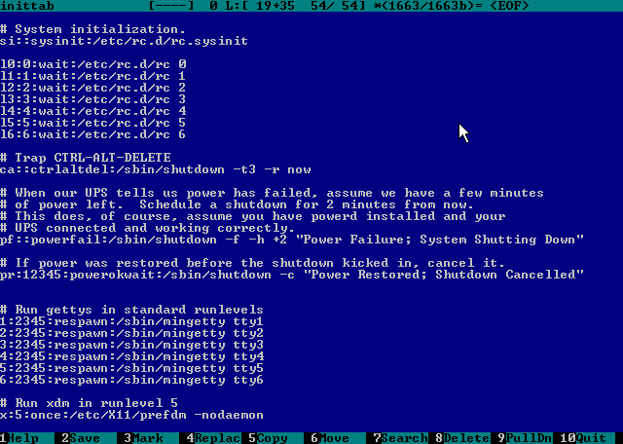

Slide 14
Logout
To exit from the shell, use the exit command
Pressing Ctrl+D at the shell prompt will also quit the shell
Quitting all programs should log you out
If in a text-only single-shell environment, exiting the shell should be sufﬁcient
In a window environment, the window manager should have a log out command for this purpose
After logging out, a new login prompt should be displayed
Notes:
Once your are in a shell program, you can logout and return to previous program. You can use the command logout, exit or press enter to do it. If the shell is primary, i.e starting by the system, Linux will restart the shell.

Slide 15
Stop the system
Shutdown the system
Restart the system
Halt the system
Notes:
To stop the system we can use the commands shutdown, restart and halt. These command can configure a customized shutdown and restart action such as informing users and programs to complete the current task.

Slide 16
Summary
Flow of system startup
Lilo/Grub configuration
Inittab configuration
runlevel and init command
Startup programs and services

